Slide 1
ReleaseIQ
Verizon Hackathon 2026
AI-powered release knowledge and troubleshooting assistant
Jira tickets + source code, one trustworthy answer · [Mad Kings] · [Sujal Mangesh Limje and Aman Mathur]

Slide 2
The two-parted problem and our solution
Part 1 · Customers and end users
Part 2 · Tier 2 support
Problem
Problem
Frequent releases (e.g. FUZE) leave users unsure what changed. Confused by new features, they raise AYS tickets, flooding the queue during every release.
To understand an issue, support reads the documentation or scavenges the whole codebase, which can take hours per ticket.
▼
▼
ReleaseIQ solution
ReleaseIQ solution
ReleaseIQ pinpoints the relevant ticket and code, flags doc-vs-code gaps and drafts a summary, cutting resolution time.
Users get plain-language answers from Jira and code, so they self-serve and the ticket is never raised.
2

Slide 3
Key features
Query understanding
Hybrid search
Cascade routing
LLM detects intent and writes 3 search rewrites.
Vector and keyword search fused with RRF.
Jira first, then code, then an honest fallback.
Mismatch detection
AYS ticket fallback
Traceable sources
Cross-checks Jira facts against code facts.
Out of scope or unknown? It asks the user to raise an AYS ticket, with a ready summary.
Ticket IDs, fix versions, file paths and lines.
Guardrails
Fast and cheap
Prompt-injection screen, secret redaction, read-only.
Fuzzy query cache and local embeddings.
3

Slide 4
Data sources
Jira ticket dump
Application source code
76 NimbusPay (NPAY) tickets: stories, bugs and tasks. Fields: key, type, status, fix version, components, description, acceptance criteria, comments, known issues and workarounds, user impact. Chunked per section so answers cite exact parts.
NimbusPay sample app in Python and YAML: approvals, expenses, reports, notifications, config and feature flags. Chunked per function or class with line numbers, plus a plain-English digest per file. Secrets are redacted.
Built-in discrepancies to test with: upload limit (Jira 50 MB vs code 10 MB), Excel export hidden behind the reports_excel flag, undocumented duplicate-receipt check, token rule added in PR #45.
4

Slide 5
Our sample app: NimbusPay
What it is
Why we built it
A mock enterprise expense portal. Employees submit expenses and receipts, managers approve them, finance exports reports. Also called NextPay, Jira key NPAY.
ReleaseIQ needs a realistic product to learn from. NimbusPay is the ground-truth codebase, with Jira history that sometimes contradicts the code.
Name nod: Nimbus is a Rick and Morty reference, after Mr. Nimbus, Rick’s ocean-dwelling nemesis. He controls the police
76
5
v3.4–3.9
4
Jira tickets (NPAY)
backend domains
release range
error codes
ReleaseIQ · Corporate Hackathon
5

Slide 6
NimbusPay: what it does
Expenses
Approvals
Reports
Receipt upload, mileage claims, auto-saved drafts, meal limits by city tier and duplicate receipt checks.
Managers approve or reject, delegate during PTO, and pending items escalate after 7 days.
CSV and Excel export once a date range is chosen, capped at 10,000 rows.
Profile and access
Config and flags
Error codes
Dark mode toggle, three roles (Employee, Approver, Admin) and a 20-minute session timeout.
YAML settings and feature flags like reports_excel switch features per tenant.
UPL-413 upload size, EXP-1042 policy limit, DEL-422 delegation, RPT-429 export rows.
ReleaseIQ · Corporate Hackathon
6

Slide 7
NimbusPay: release history
Version
Date
Feature
Key rule
3.4.0
Feb 2026
Mileage claims
Max 500 km per claim, 0.55 per km
3.4.5
Feb 2026
Dark mode
Toggle under Profile, Appearance
3.5.0
Mar 2026
Bulk receipt upload
Up to 20 JPG, PNG or PDF files
3.5.0
Mar 2026
Policy limit warnings
Warn at 80%, block at 100% unless justified
3.6.0
May 2026
Excel export
Behind reports_excel flag, 10,000 rows
3.6.1
May 2026
Export button fix
Enabled only after a date range is set
3.7.0
Jun 2026
Auto-save drafts
Every 30 seconds, expire after 14 days
3.8.0
Jul 2026
Delegated approvals
APPROVER role only, up to 30 days
3.9.0
Aug 2026
Admin token block
Admin tokens rejected (NPAY-123, PR #45)
3.9.0
Unreleased
Multi-currency
Picker hidden unless cost center allows
ReleaseIQ · Corporate Hackathon
7

Slide 8
NimbusPay: where Jira and code disagree
Upload limit
Feature flags
Jira (NPAY-1042) promises 50 MB per receipt. The code enforces 10 MB after an infra incident, so users hit UPL-413.
Excel export exists, but reports_excel is off by default. An admin must enable it per tenant.
Code-only behavior
Release gaps
Duplicate receipt detection, the weekend expense flag, the 20-minute session timeout and 7-day escalation have no ticket.
Multi-currency is still unreleased. The 3.9.0 token rule rejects admin tokens, which can break older integrations.
ReleaseIQ · Corporate Hackathon
8

Slide 9
Demo questions by scenario
Jira only
Jira and code
“How do I enable dark mode?”
“Why does my 15 MB receipt upload fail?”
Steps from the Profile, Appearance ticket.
Flags 50 MB in Jira vs 10 MB in code.
Code only
Not found
“What if my manager does not approve within 7 days?”
“How do I set up SSO with Okta?”
Answers from the escalation rule.
Says it cannot find it and asks for an AYS ticket.
ReleaseIQ · Corporate Hackathon
9

Slide 10
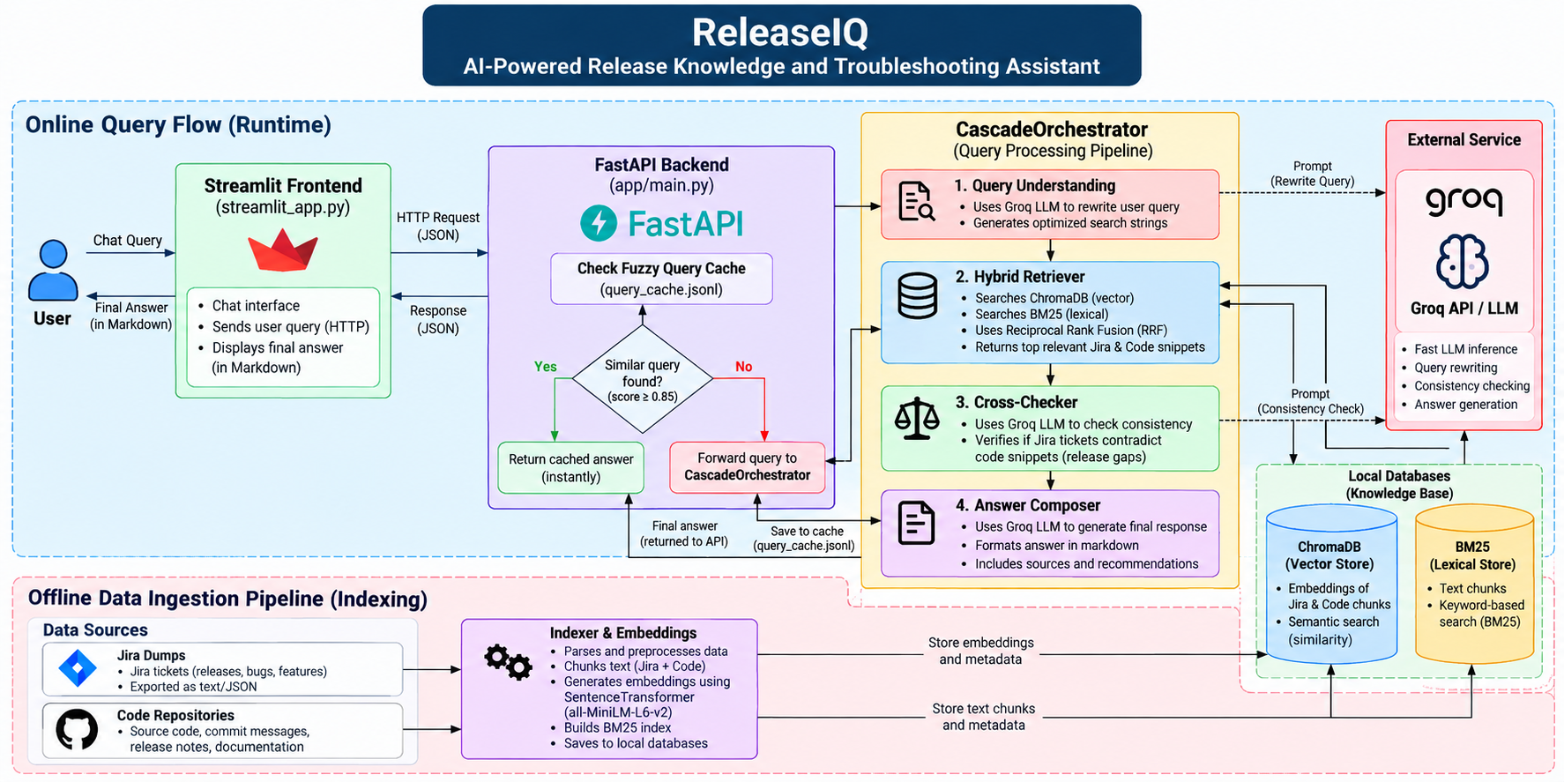
System architecture
10

Slide 11
Components: interface and services
USER LAYER
API LAYER
Streamlit frontend
FastAPI backend
Chat UI that sends each question to the API and shows the answer, route, confidence, sources, mismatch alerts and the support note.
Serves chat, feedback, health and admin endpoints. Screens prompt injection, tags every request with an ID and auto-ingests data on startup.
SPEED AND CONTEXT
EXTERNAL SERVICE
Fuzzy cache and sessions
Groq LLM
Similar past questions (0.85+ match) return instantly. Session memory keeps the last turns so follow-ups make sense.
Fast inference for query rewriting, consistency checks, answer writing and file digests. Gemini and OpenAI can be swapped in.
ReleaseIQ · Corporate Hackathon
11

Slide 12
Components: the cascade pipeline
STEP 1
STEP 2
Query understanding
Hybrid retriever
Finds intent, error codes and UI terms, then writes three search rewrites. Uses chat history only to resolve “it” and “that feature”.
Runs vector and BM25 search for every rewrite and merges them with Reciprocal Rank Fusion. A confidence score decides Jira, code or fallback.
STEP 3
STEP 4
Cross-checker
Answer composer
Compares concrete facts in Jira and code, such as limits, roles and button names, and flags a mismatch with user-facing guidance.
Writes short numbered steps for non-technical users from retrieved context only. Adds the AYS ticket request when nothing is found.
ReleaseIQ · Corporate Hackathon
12

Slide 13
Components: knowledge base and ingestion
OFFLINE
OFFLINE
Parsers and chunkers
Indexer and embeddings
The Jira parser splits each ticket into sections. The code scanner chunks by function and class, adds a plain-English digest and redacts secrets.
Embeds chunks locally with all-MiniLM-L6-v2 and writes both stores. A hash manifest skips Jira data that has not changed.
LOCAL STORE
LOCAL STORE
ChromaDB vector store
BM25 lexical store
Two collections, Jira tickets and code chunks, for semantic search by meaning.
Keyword index for exact matches such as error codes like UPL-413 and ticket keys.
ReleaseIQ · Corporate Hackathon
13

Slide 14
How it works
1
Cache and security
Prompt-injection screen, then a fuzzy cache (similarity 0.85+) for instant repeat answers.
2
Query understanding
Groq LLM classifies intent and rewrites the question into search strings.
3
Hybrid retrieval
ChromaDB vectors + BM25 merged by RRF. Jira first, code if confidence is low.
4
Cross-checker
LLM compares limits, roles and flags in Jira against the code.
5
Answer composer
Plain-English steps, sources, mismatch warning and support note.
Offline: the indexer parses Jira and code, chunks them, embeds with all-MiniLM-L6-v2 and builds the BM25 index. A hash manifest skips unchanged data.
14

Slide 15
Technologies used
Backend and API
LLM layer
Retrieval
Python 3.11, FastAPI, Uvicorn, Pydantic.
Groq (gpt-oss-120b) by default. Gemini and OpenAI are pluggable.
ChromaDB, rank-bm25, Reciprocal Rank Fusion.
Embeddings
Frontend
Quality and ops
SentenceTransformers all-MiniLM-L6-v2, runs locally with no API key.
Streamlit chat UI with sources, route and mismatch alerts.
Docker Compose, pytest and an eval suite for route accuracy.
15

Slide 16
Strengths
Catches doc-vs-code drift
Grounded and cited
Honest fallback
Surfaces contradictions that plain RAG chatbots hide.
Answers come only from retrieved context, with sources.
Says “not found” and asks the user to raise an AYS ticket.
Built for non-technical users
Safe by design
Low cost, vendor-neutral
Numbered steps, bold UI labels, no code in answers.
Injection screening, secret redaction, read-only guide.
Local embeddings and swappable LLM providers.
16

Slide 17
Future enhancements
Live git integration
More sources
Smarter retrieval
Real git blame, commits and PRs instead of simulated history.
Confluence, Slack, release notes and support tickets.
Cross-encoder reranker, calibrated confidence, semantic cache.
Enterprise ready
Feedback loop
Proactive intelligence
SSO, role-based access, multi-tenant data and audit logs.
Use thumbs up/down to grow the eval set and tune thresholds.
Drift alerts in CI and auto-drafted release notes.
17

